Slide 1
Ganga Basin Hydrologic Regime – Environmental Flow Perspective
World Bank and INRM Consultants New Delhi
February, 2015

Slide 2
Ganga Water Balance Flow Chart
Ganga Water Resources
Country
Stream Flow (BCM)
Scenario A
Annual
Tables
Graphs
Layouts
Monthly
Scenario B
Water Balance (BCM) Precipitation, Water Yield, ET
Scenario A
Annual
Tables
Graphs
Layouts
State
Major Basins
Districts
Tables
Graphs
Layouts
Annual
Tables
Graphs
Layouts
Monthly
Tables
Graphs
Layouts
Monthly
Tables
Graphs
Layouts
Scenario B
Annual
Tables
Graphs
Layouts
Monthly
Tables
Graphs
Layouts
Same as Country & Sediment & BOD
Water Balance (BCM) Precipitation, Water Yield, ET
Same as Country

Slide 3
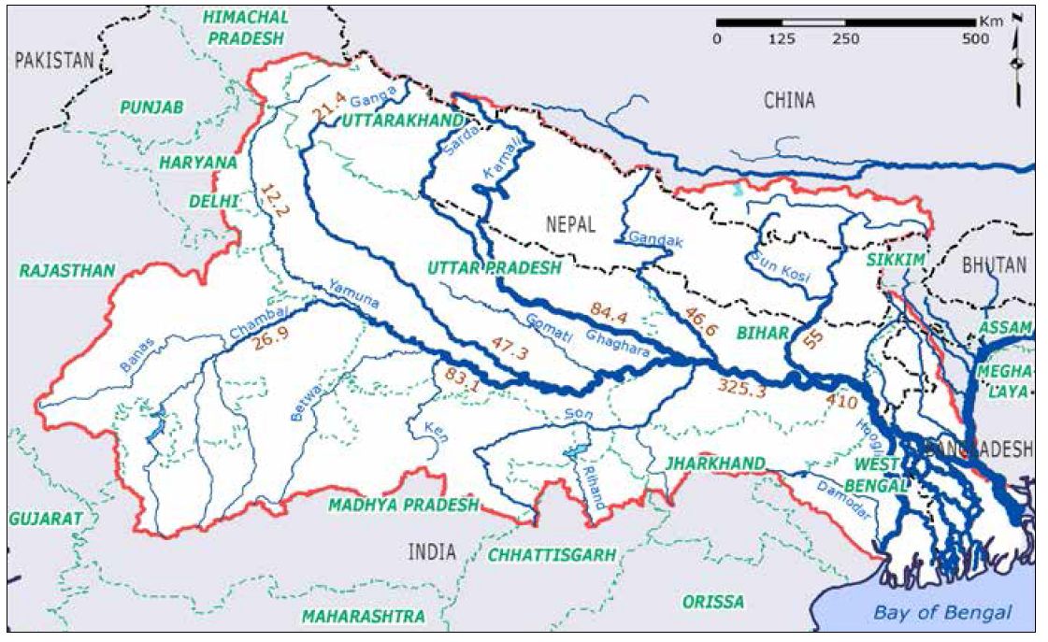

Slide 4
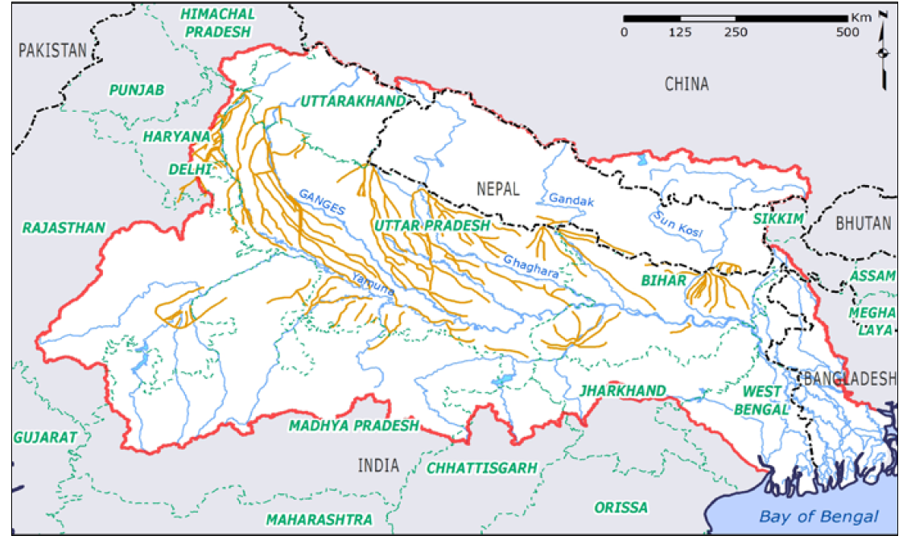

Slide 5
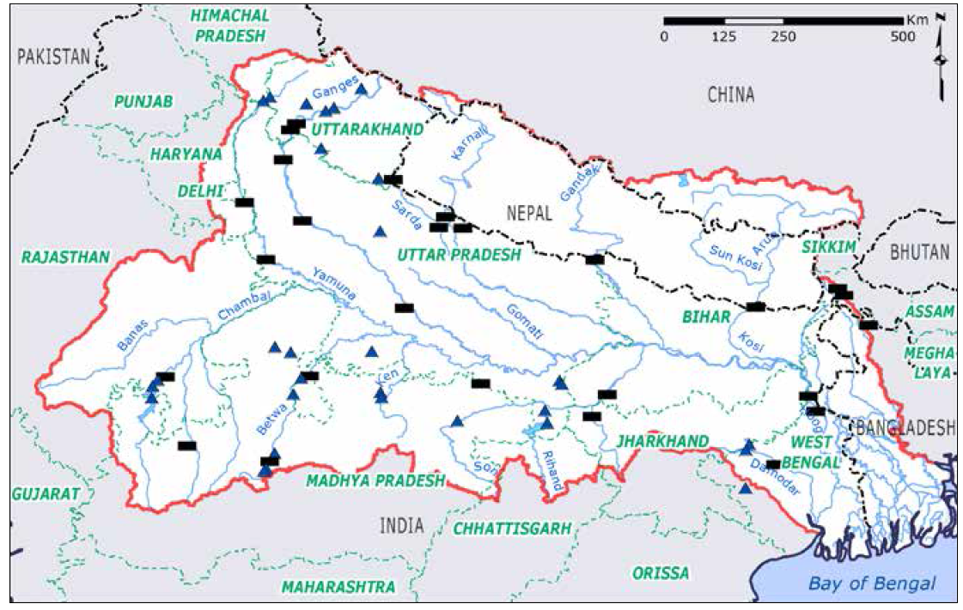

Slide 6
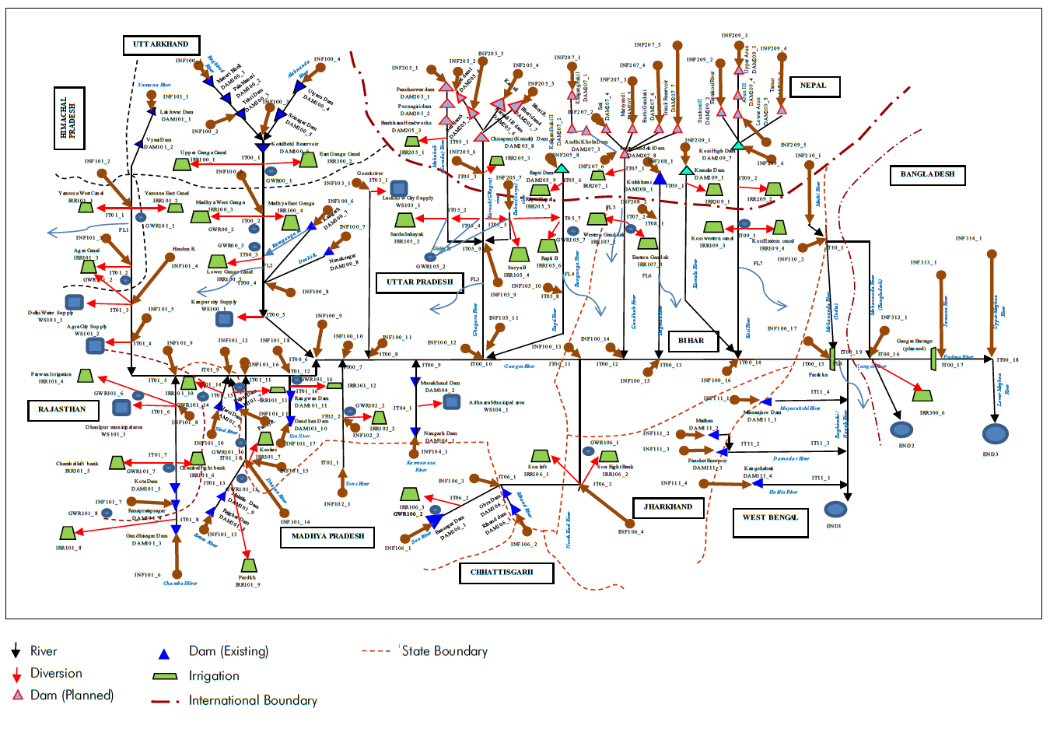

Slide 7
Annual Outflow of Major Tributaries of the Ganga Basin - % Change w.r.t. Pre development Scenario
Draft Not For Circulation

Slide 8
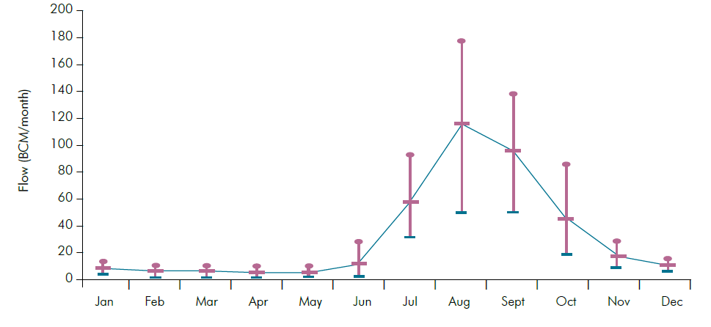

Slide 9
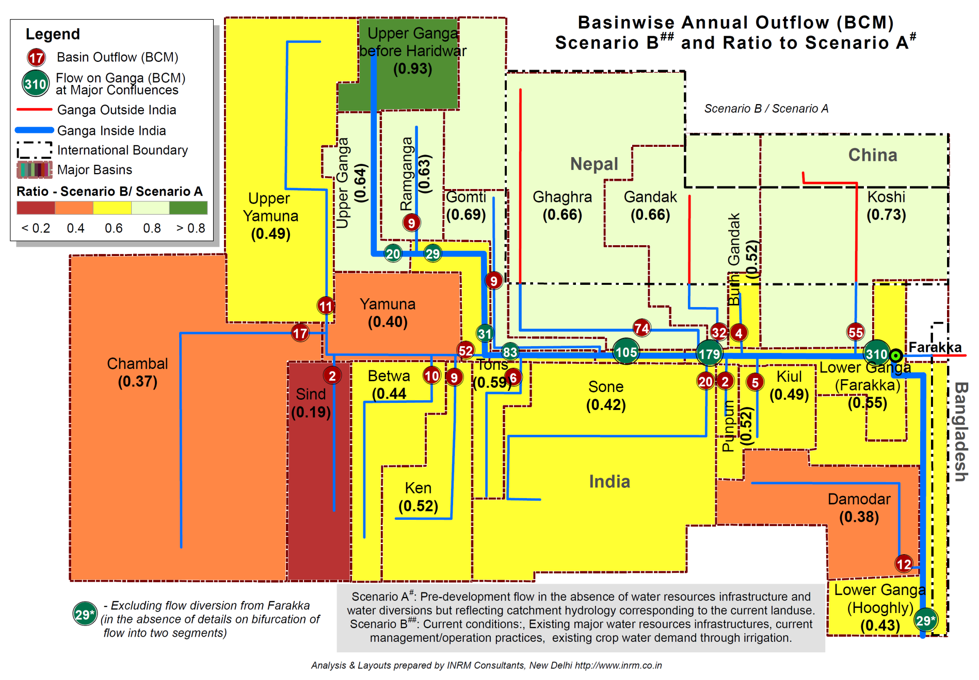
Annual Outflow of Major Tributaries of the Ganga Basin – Ratio Post/Pre development Scenario
Draft Not For Circulation

Slide 10
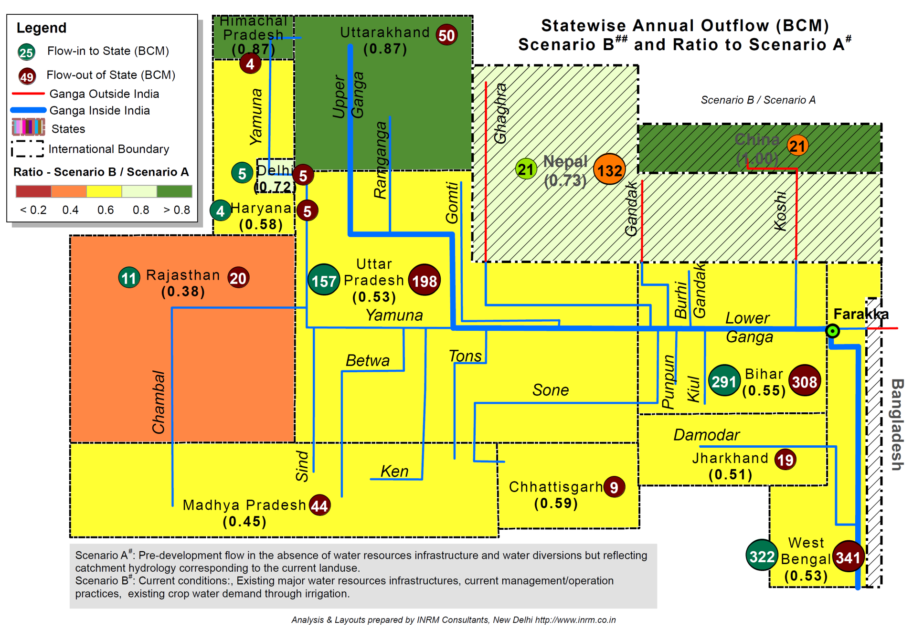
Annual Outflow of States of the Ganga Basin – Ratio Post/Pre development Scenario
Draft Not For Circulation

Slide 11
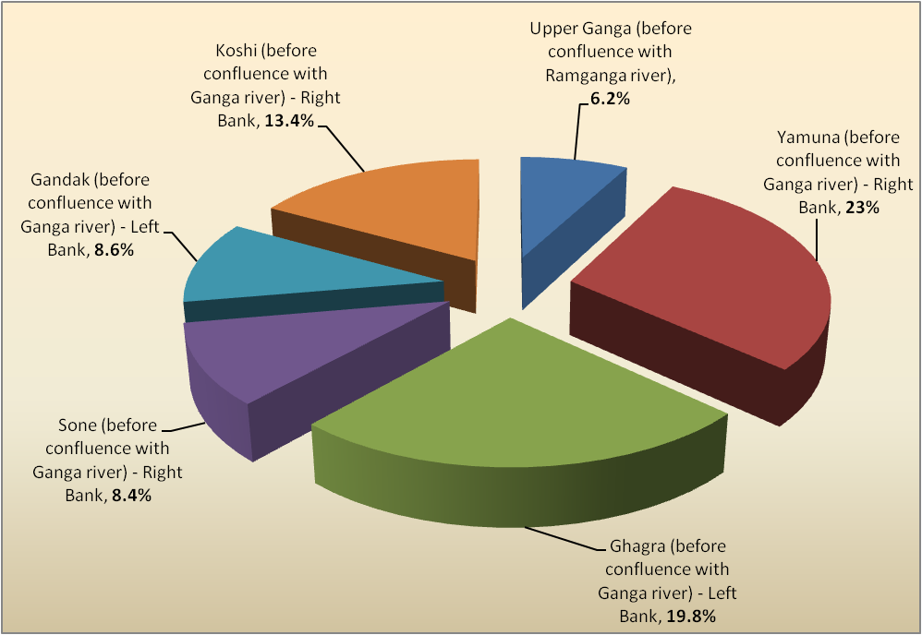

Slide 12
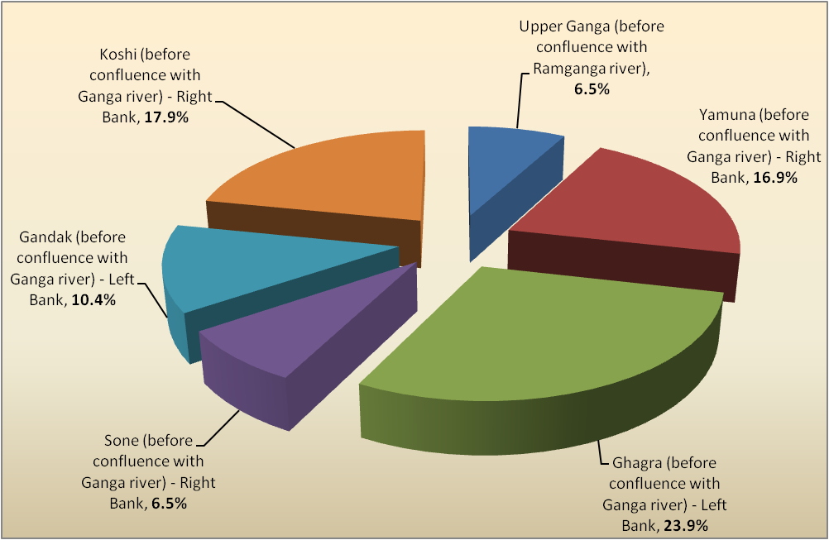

Slide 15
Ecosystem Significance of Flow health parameters
For Your Reference
Highest Monthly Flow (HMF)
Magnitude of flood flows which are critical for inundating wetlands, cuing fish spawning behaviour, facilitating fish migration and mobilising sediment for creation of physical habitat.
Lowest Monthly Flow (LMF)
Magnitude of the lowest flow of the year, when minimum flows are required for survival
HMF and LMF are not determined for the high flow and low flow seasons respectively, but for the entire year.
Highest and Lowest flow Volume (HF& LF)
Total seasonal volume will reflect the prevailing natural hydrological conditions (in particular, highlighting dry years) and also indicate any major reductions in total flow volume (and hence gross habitat area availability) due to flow regulation
Significant regulation impacts would tend to be characterised by a sustained reduction in HFV, perhaps also with a sustained reduction in LFV.
Persistently Higher flow (PHF)
Intended to relate to the situation of flows being artificially regulated at significantly higher than reference magnitude for long periods through the low flow period.
This can reduce light penetration to the bed, and hence reduce primary production of benthic algae
Persistently elevated low flows might also mean that invertebrates are not seasonally stressed, which could be a natural disturbance process that plays a role in maintaining diversity
Higher than normal flows in the low flow period can also stress riparian vegetation by waterlogging root zones, or preventing recruitment in exposed soils.
Persistently Lower flow (PLF)
Intended to relate to the situation of flows, either in the low or high flow season, being depressed for long periods.
This indicator would usually indicate persistently depressed low flow season flows, which would have implications for gross habitat area availability for fish and macroinvertebrates.
This flow condition would potentially allow colonisation of the stream bed by invasive vegetation, or accummulation of fine sediments that settle out during periods of low flow. In a river with a high level of flow diversion, a high proportion of the year could have markedly depressed flows, which could impact the entire life cycles of many aquatic organisms.
6. Persistently very Low ( PVL):
Relates to the situation of flows being artificially regulated at very low levels for long periods through the low flow period. T
The consequences of this drying or near-drying of the channel can be critical for all organisms in the stream.
Very low flows are often associated with the loss of riffle habitats, crowding in pools and degraded water quality, such as temperature extremes and increased risk of hypoxia and high salinity.
Seasonal flow shift (SFS) :
relates to the situation of the seasonal pattern of flows being reversed, or partly reversed, due to storage of flows in the natural high flow season, and release of flows for downstream supply in the natural low flow season.
The consequences of this can be disruption of the natural timing of flow pulses and baseflows that stimulate the behaviour of aquatic organisms whose life cycle has adapted to a particular seasonal pattern of flow.

Slide 16
Yamuna Basin - Flow Health Assessment
Chambal
Ken
Sind
Yamuna
Draft Not For Circulation
Betwa
9 hydrological sub indicators
High Flow (HF)
Low Flow (LF)
Highest Monthly (HM)
Lowest Monthly (LM)
Persistently Higher (PH)
Persistently Lower (PL)
Persistently Very Low (PVL)
Seasonality Flow Shift (SFS)
Flood Flow Interval (FFI)
Incorporating hydrology into river health
Need a simple measurement of hydrology that relates to ecology, and human disturbance
Require a score for each year
Hydrology can be directly controlled to improve/maintain health
Score should inform the appropriate response
Flow Health Metrics developed by Dr. Christopher Gippel

Slide 17
